Slide 1
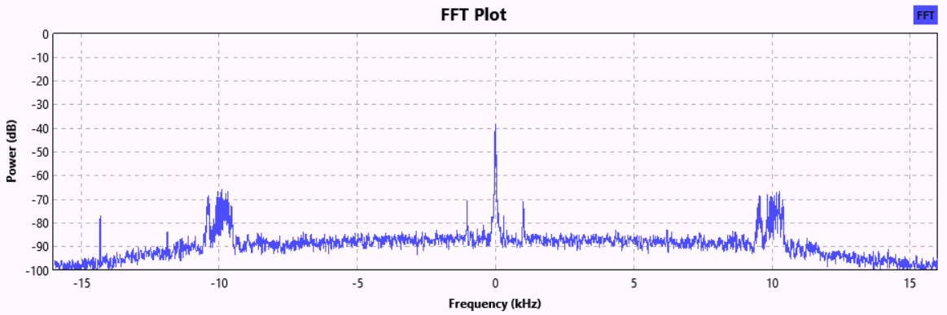

Slide 2
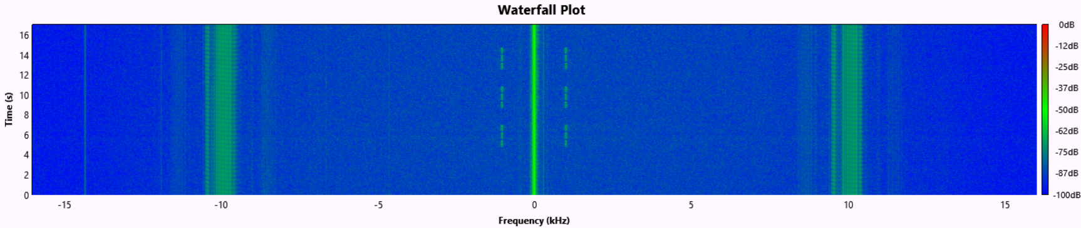

Slide 3
NW
SE
NE
SW
½ Wave Loop
½ Wave Loop
Frequency
Modulator
115.5 MHz
Carrier Generator
9960 Hz
Carrier Generator
sin
30 Hz
Signal Generator
cos

Slide 4
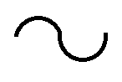
115.5 MHz
VOR Frequency
AM Demodulator
Low Pass
Filter
9960 MHz
Band Pass
Filter
FM Demodulator
30 Hz Band Pass Filter
30 Hz Band Pass Filter
Phase Comparator
(Phasor Method)
Phase (Bearing) Angle

Slide 5
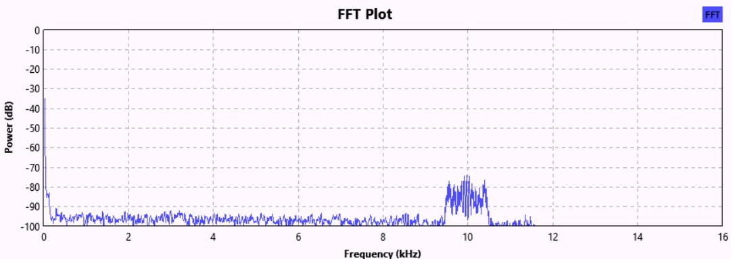
Low Frequency Spectrum
(30 Hz REF, IDent)
9960 Hz FM Spectrum
(30 Hz VAR Signal)

Slide 6
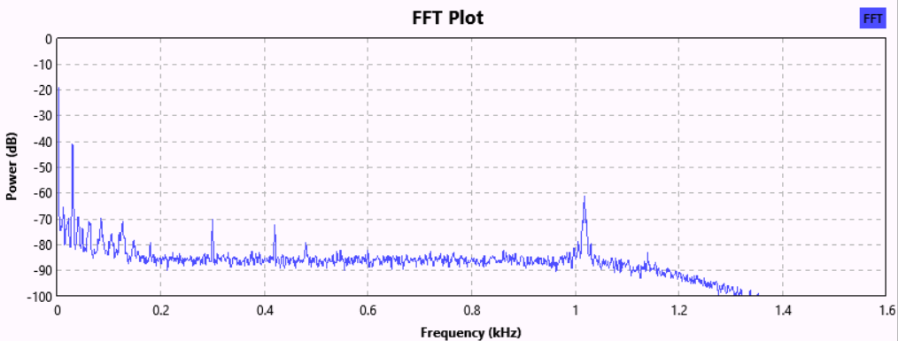
30 Hz
(REF Signal)
IDent Signal

Slide 7
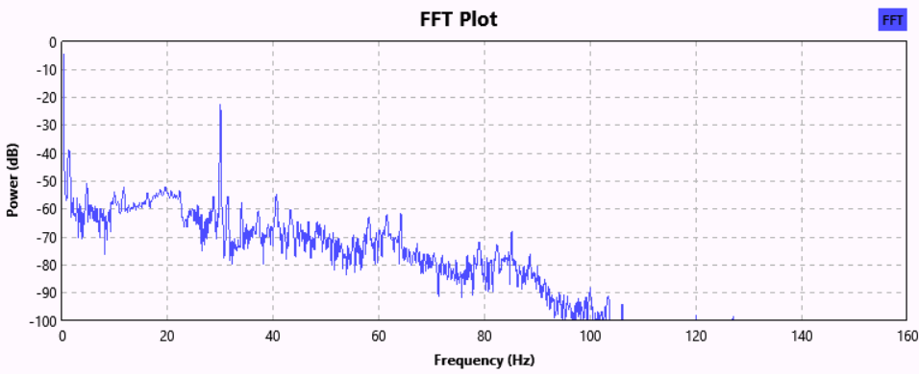
30 Hz
(REF Signal)

Slide 8
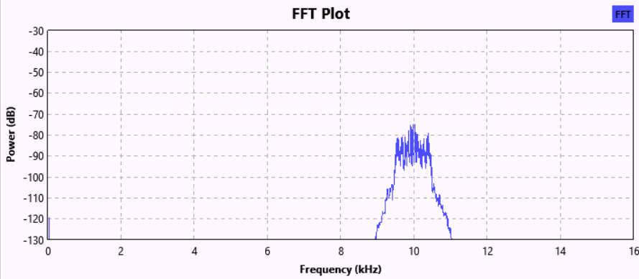
9960 Hz
FM Modulated
30 Hz VAR Signal

Slide 9
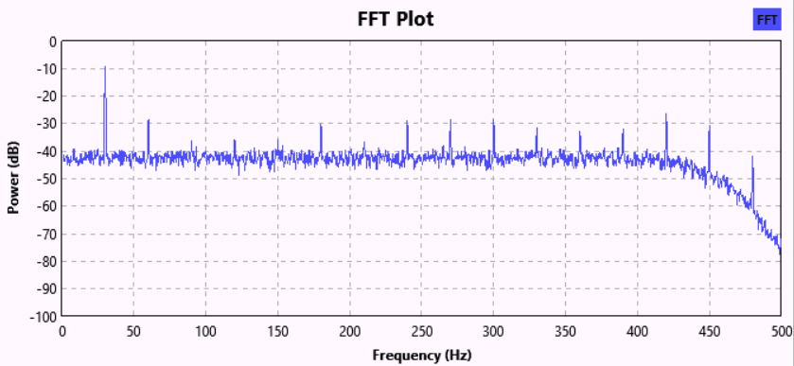
30 Hz
VAR Signal

Slide 10
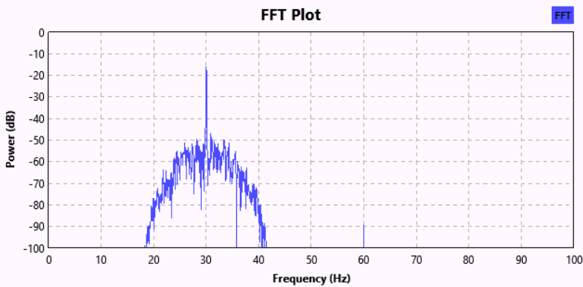
30 Hz
Reference Signal

Slide 11
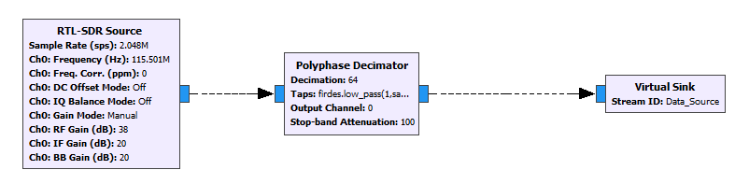
Stream ID: Data_Source
Sample Rate: 32 KHz
Decimation: 64
Low Pass Filter Spec:
Sample Rate: 2.048 MHz
Cut-off Freq.: 12 KHz
Transition Bandwidth: 16 KHz
Sample Rate: 2.048 MSPS
Frequency: 115.5 MHz
(HAL, Bangalore)
Gain: 38 dB

Slide 12
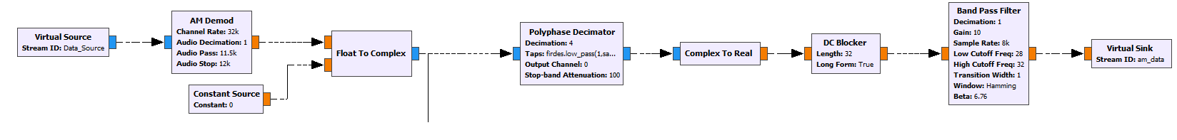
AM Demodulator
(Cutoff Freq.-11.5 KHz)
Data Source
At 32 KSPS
Phase Rotating
30 Hz at 8 KSPS
Decimation: 4
Cut-off Freq: 35 Hz
Output Sample Rate: 8 KHz
Pass-band: 28-32 KHz
Gain: 10
To 9960 Hz
Section

Slide 13
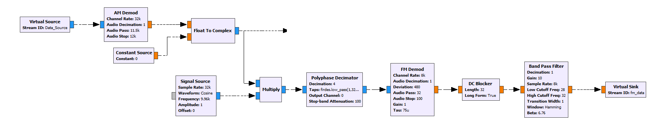
Decimation: 4
Low Pass Filter:
Cutoff Freq.: 500 Hz
Transition BW: 100 Hz
Band Pass Filter
Gain: 10
Pass band: 28 – 32 Hz
“am_data”
8 KSPS
FM Demodulator
Max. Freq. Dev: 480 Hz
Output Cutoff: 32 Hz

Slide 14
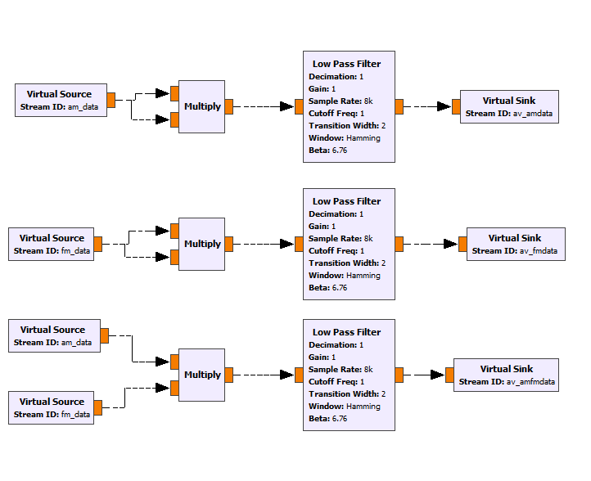
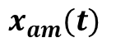
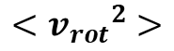
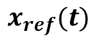
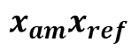
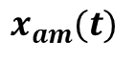
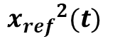
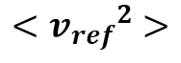
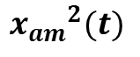
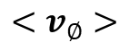
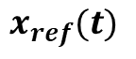
$${x_{am}}^{2}(t)$$
$$x_{am}(t)$$
$$<{v_{rot}}^{2}>$$
$${x_{ref}}^{2}(t)$$
$$x_{ref}(t)$$
$$<{v_{ref}}^{2}>$$
$$x_{am}(t)$$
$$x_{am}x_{ref}$$
$$<v_{∅}>$$
$$x_{ref}(t)$$
Estimation of Signal using 1 Hz Low Pass Filter

Slide 15
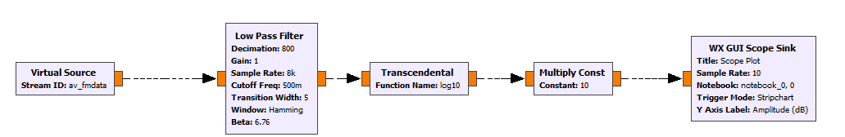
Convert Sample Point to Power (dB)
Statistical Averaged Data for 30 Hz Reference Tone
Plot the Power of Reference 30 Hz Tone
(Rate: 10 SPS)
Average further and Down convert to 10 samples/sec

Slide 16
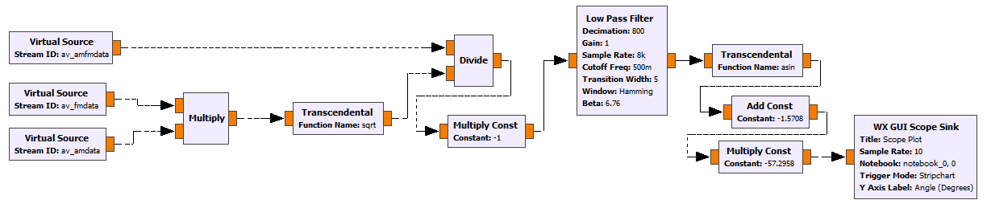
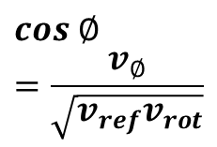
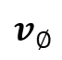
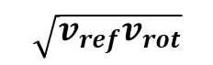
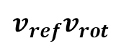
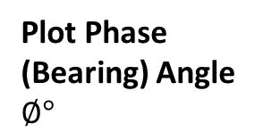
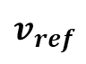
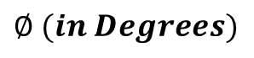
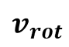
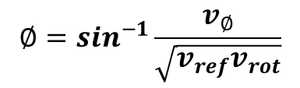
$$cos ∅=\frac{v_{∅}}{\sqrt{v_{ref}v_{rot}}}$$
$$v_{∅}$$
$$∅=\sin^{−1}\frac{v_{∅}}{\sqrt{v_{ref}v_{rot}}}$$
$$\sqrt{v_{ref}v_{rot}}$$
$$v_{rot}$$
$$v_{ref}$$
$$v_{ref}v_{rot}$$
$$∅ (in Degrees)$$
Plot Phase (Bearing) Angle $∅°$

Slide 17
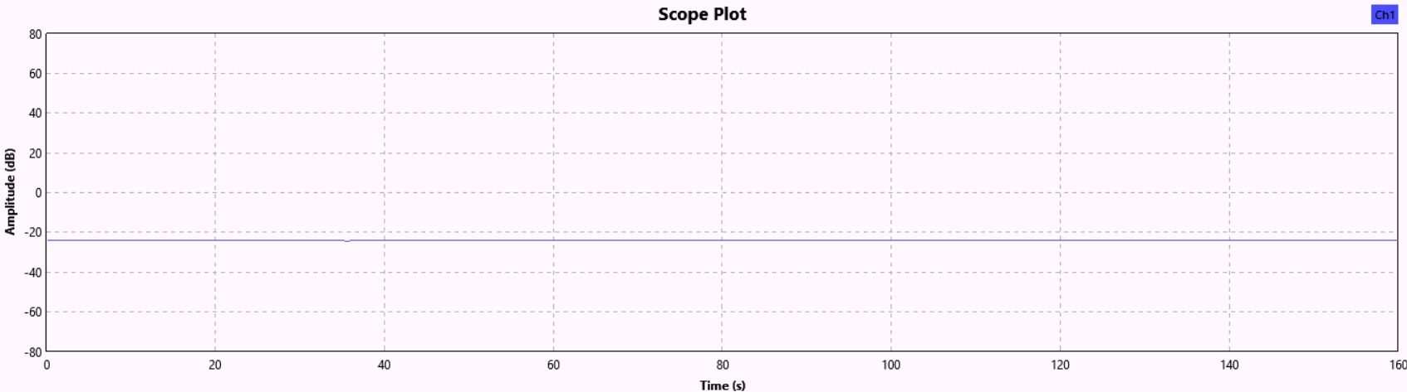
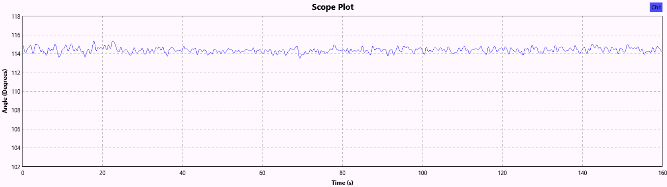
(a) Plot of Signal Level of 30 Hz Reference Tone
(b) Plot of Bearing Angle (in Degrees) vs. Time

Slide 18
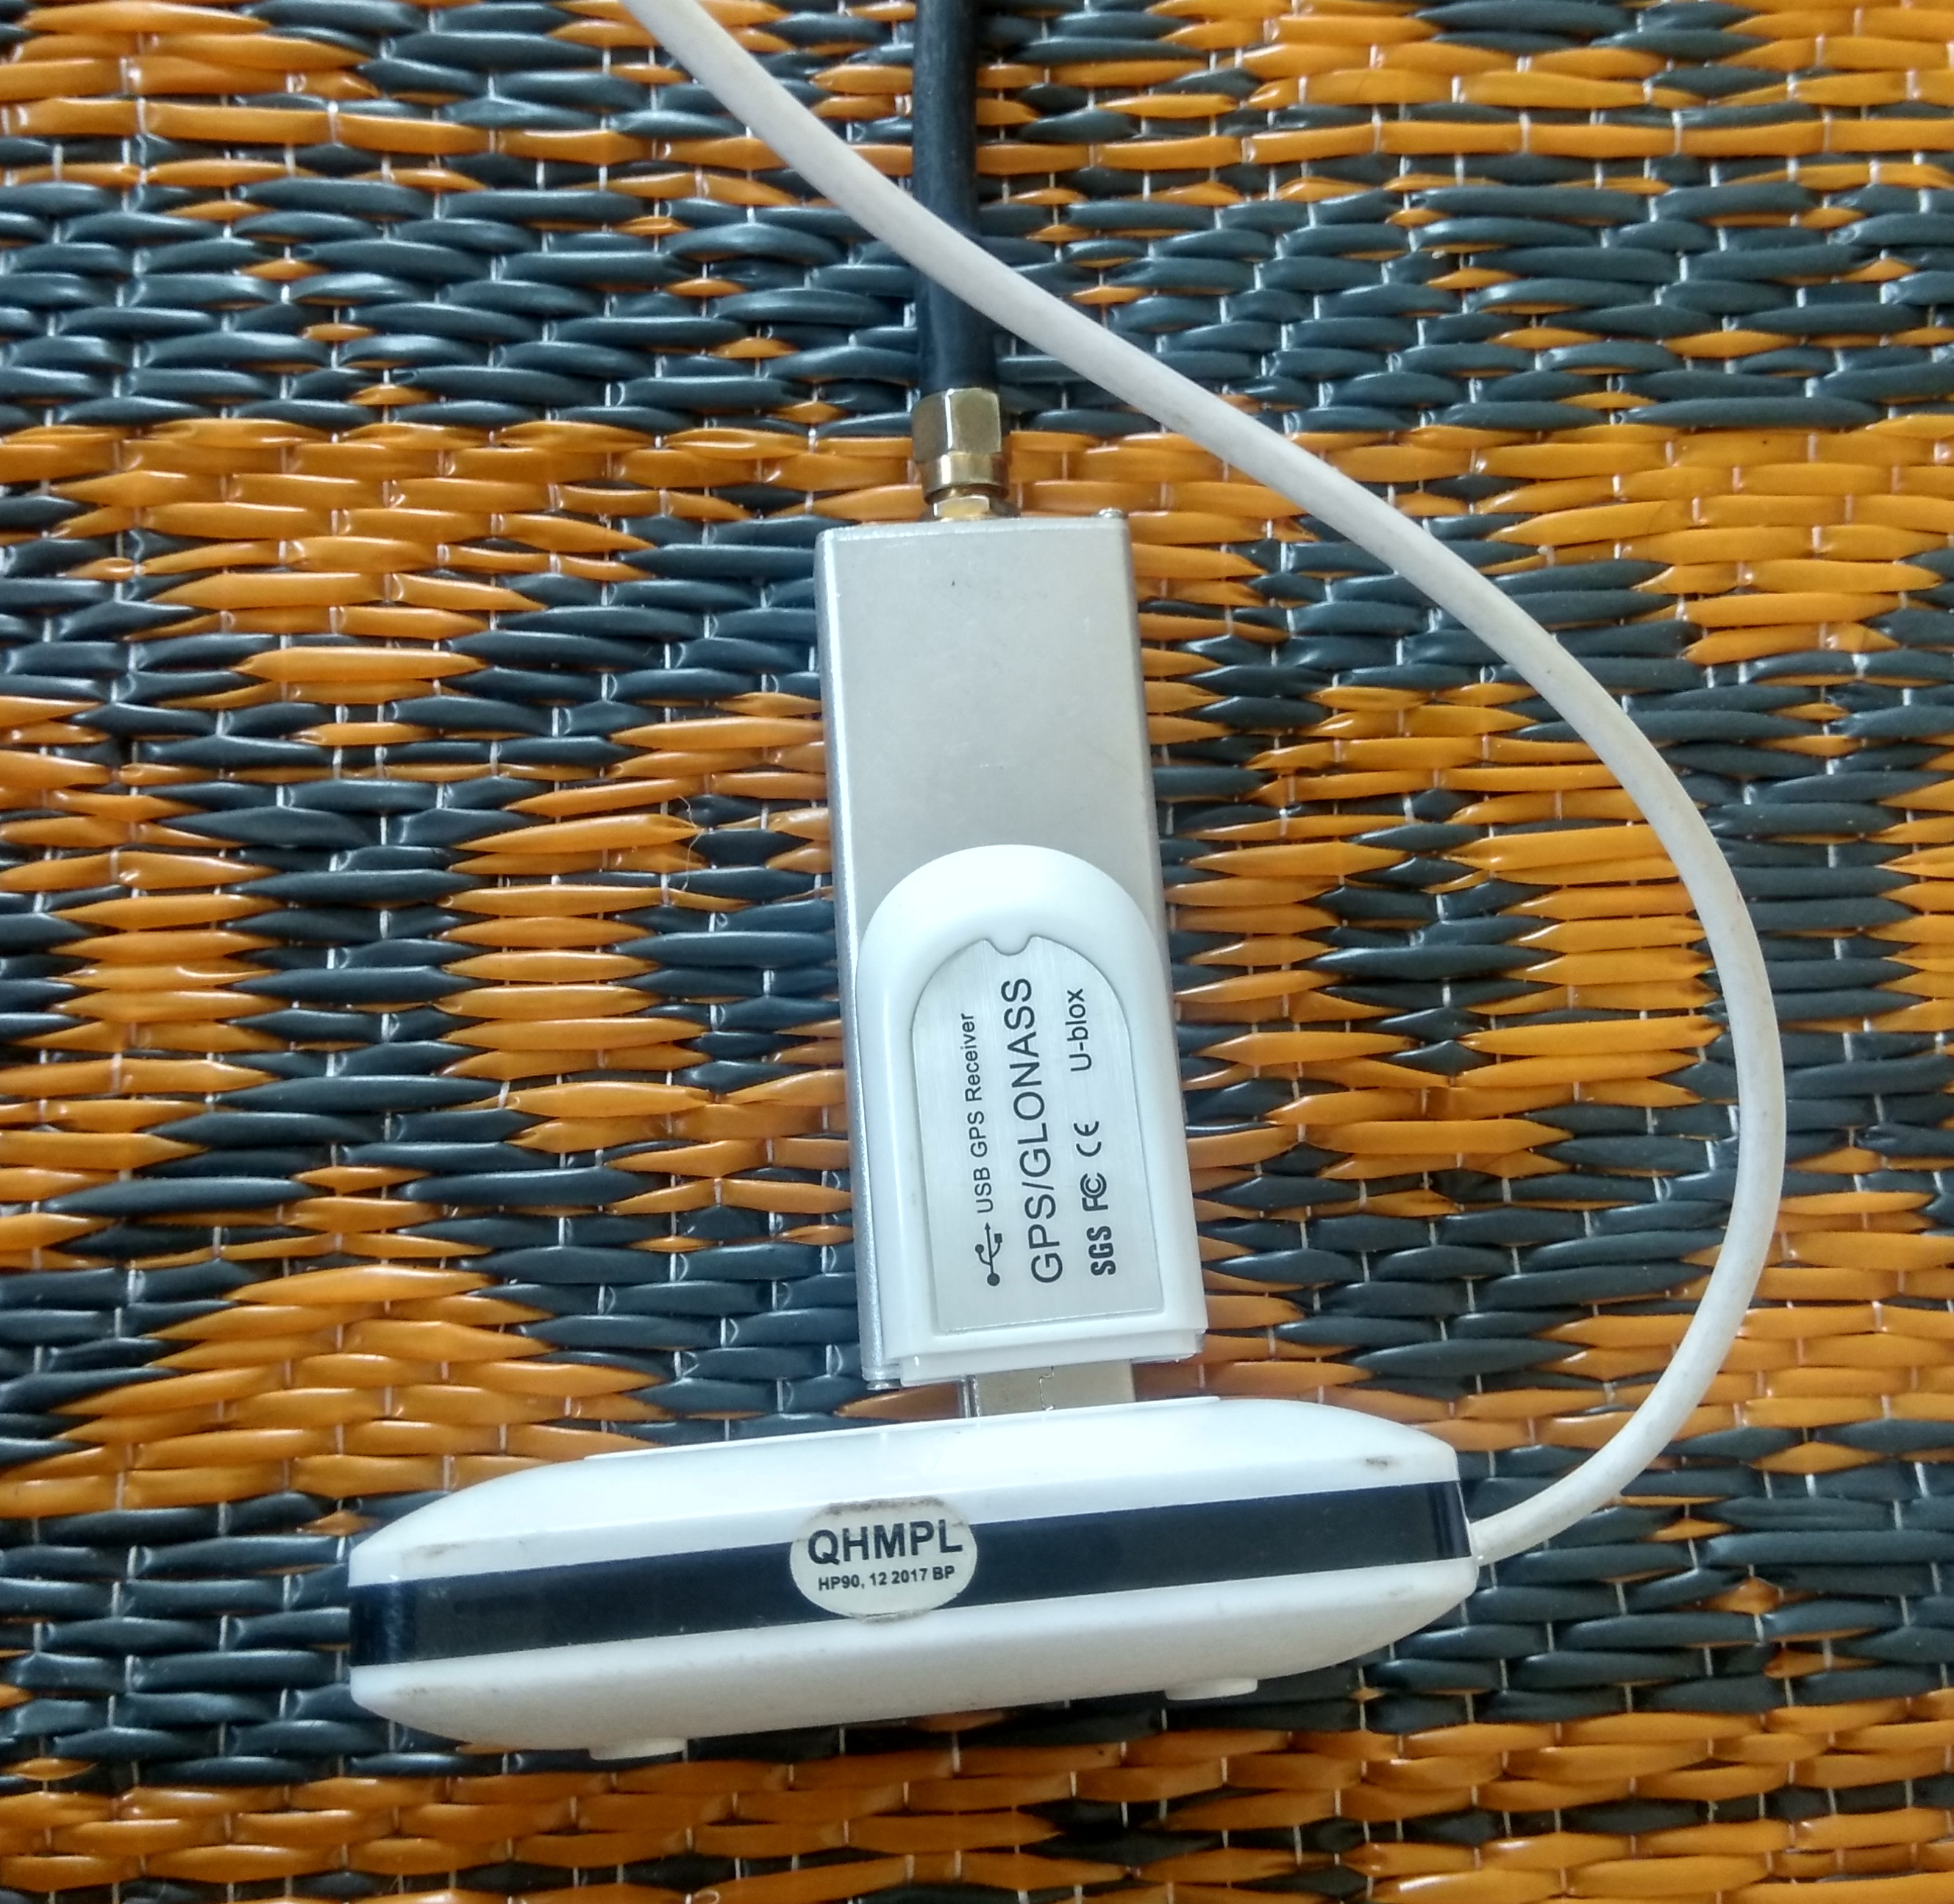
Nooelec RTLSDR
Ubox GNSS Recv.
USB Hub

Slide 19
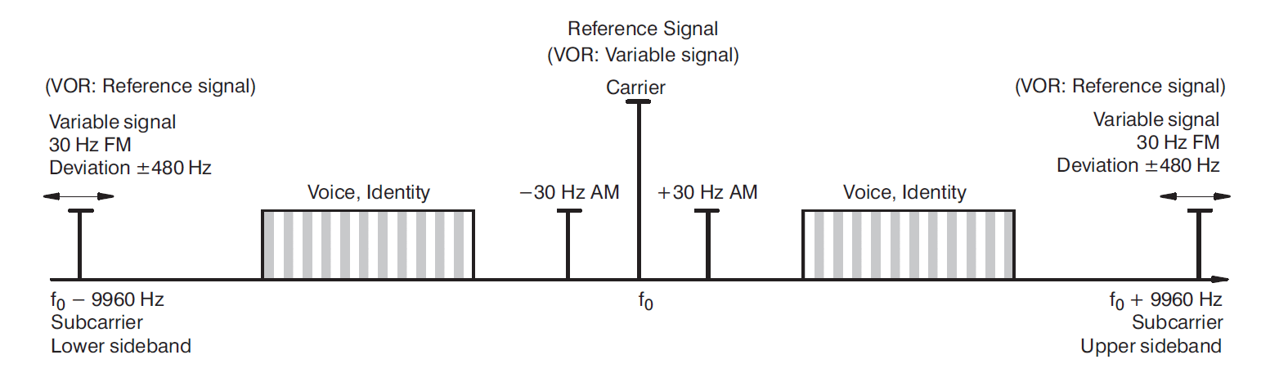

Slide 20
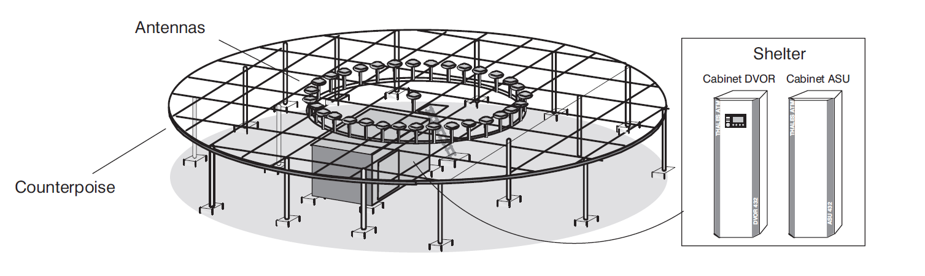

Slide 21
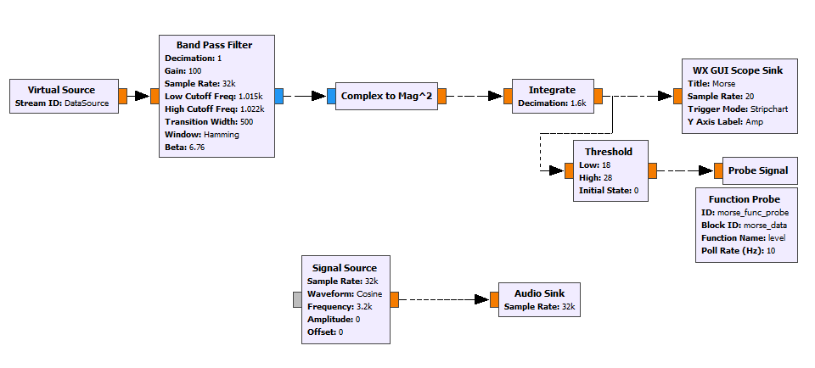

Slide 22
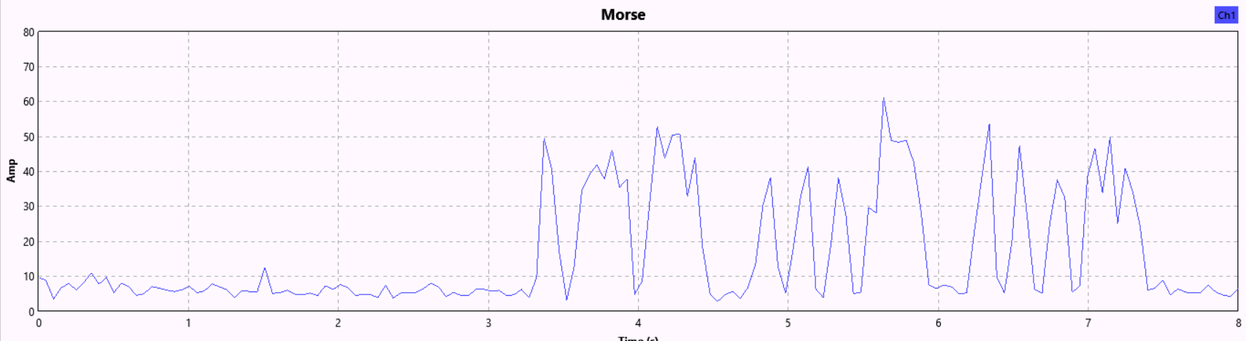
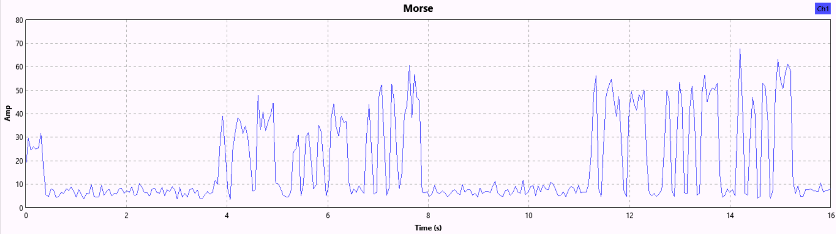

Slide 23
